Slide 1




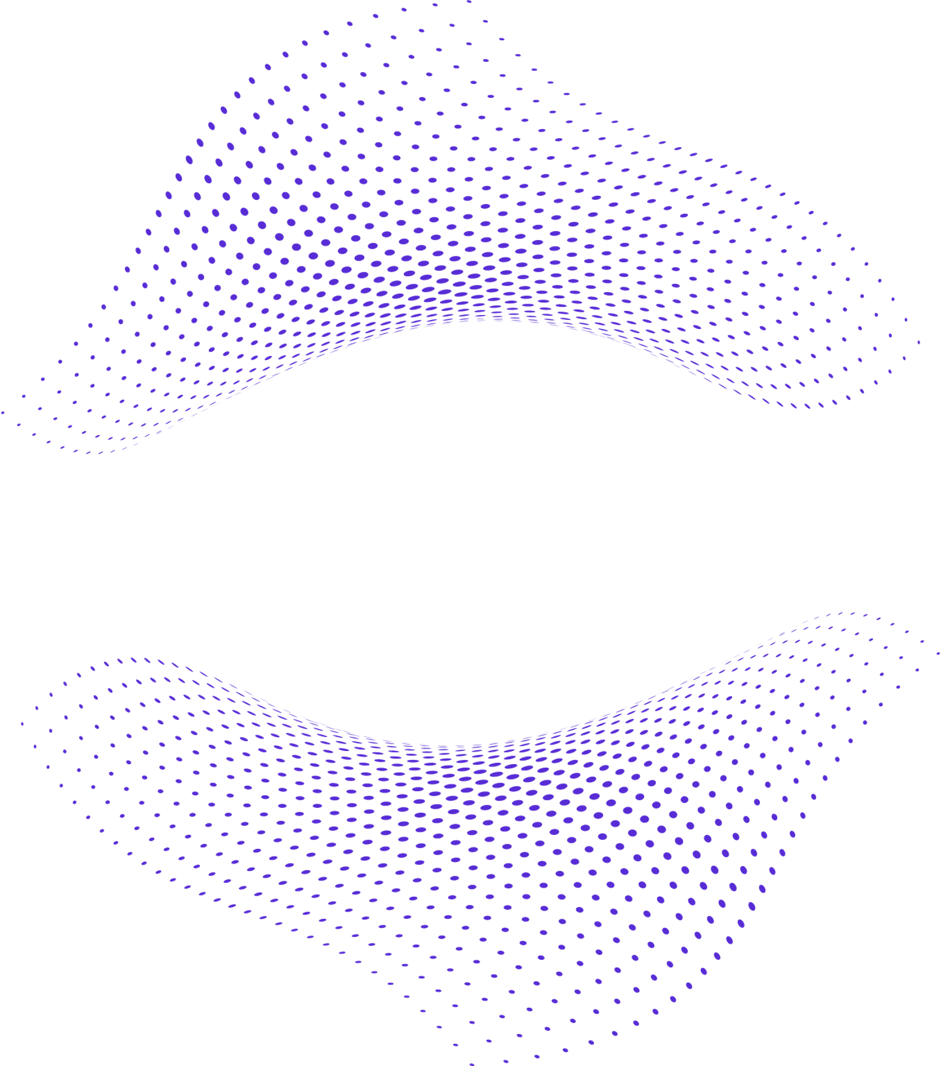
AI
APPLICATIONS IN WEB DESIGN
AND SOCIAL MEDIA COURSES
SARA SHIELDS (ASSISTANT PROFESSOR OF INSTRUCTION)

Slide 2

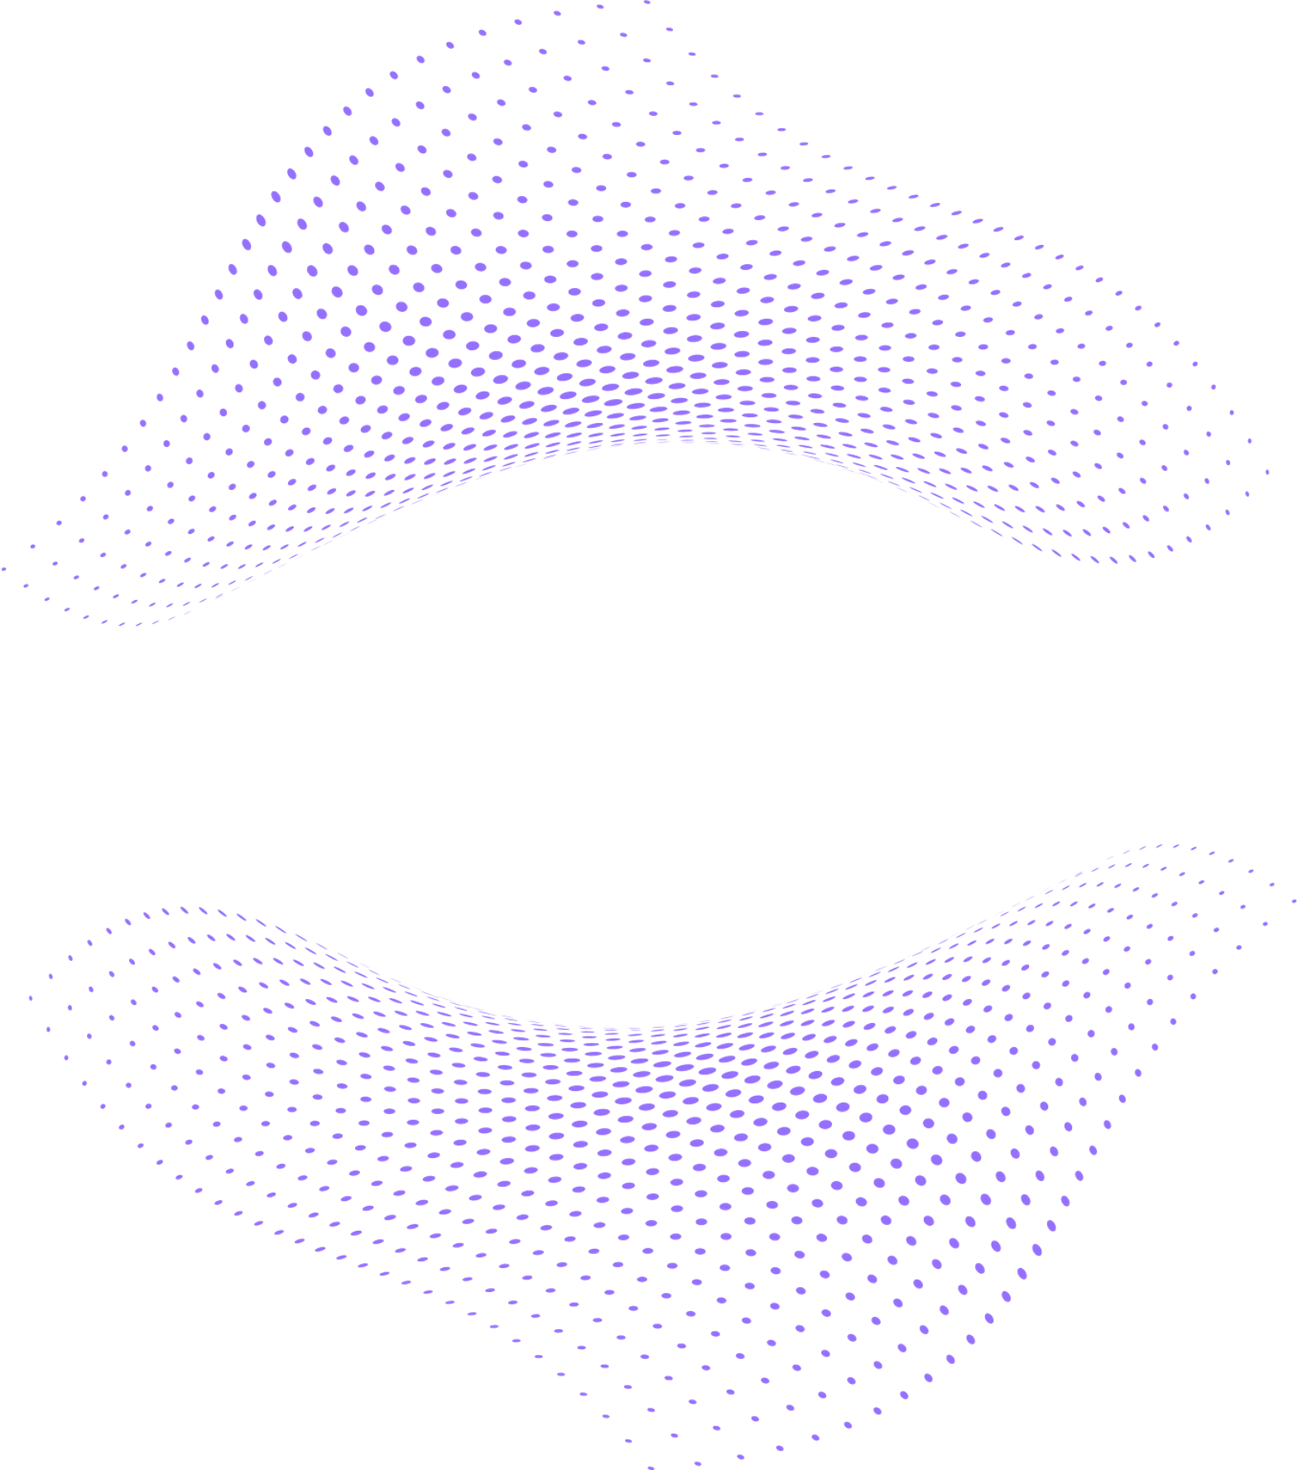

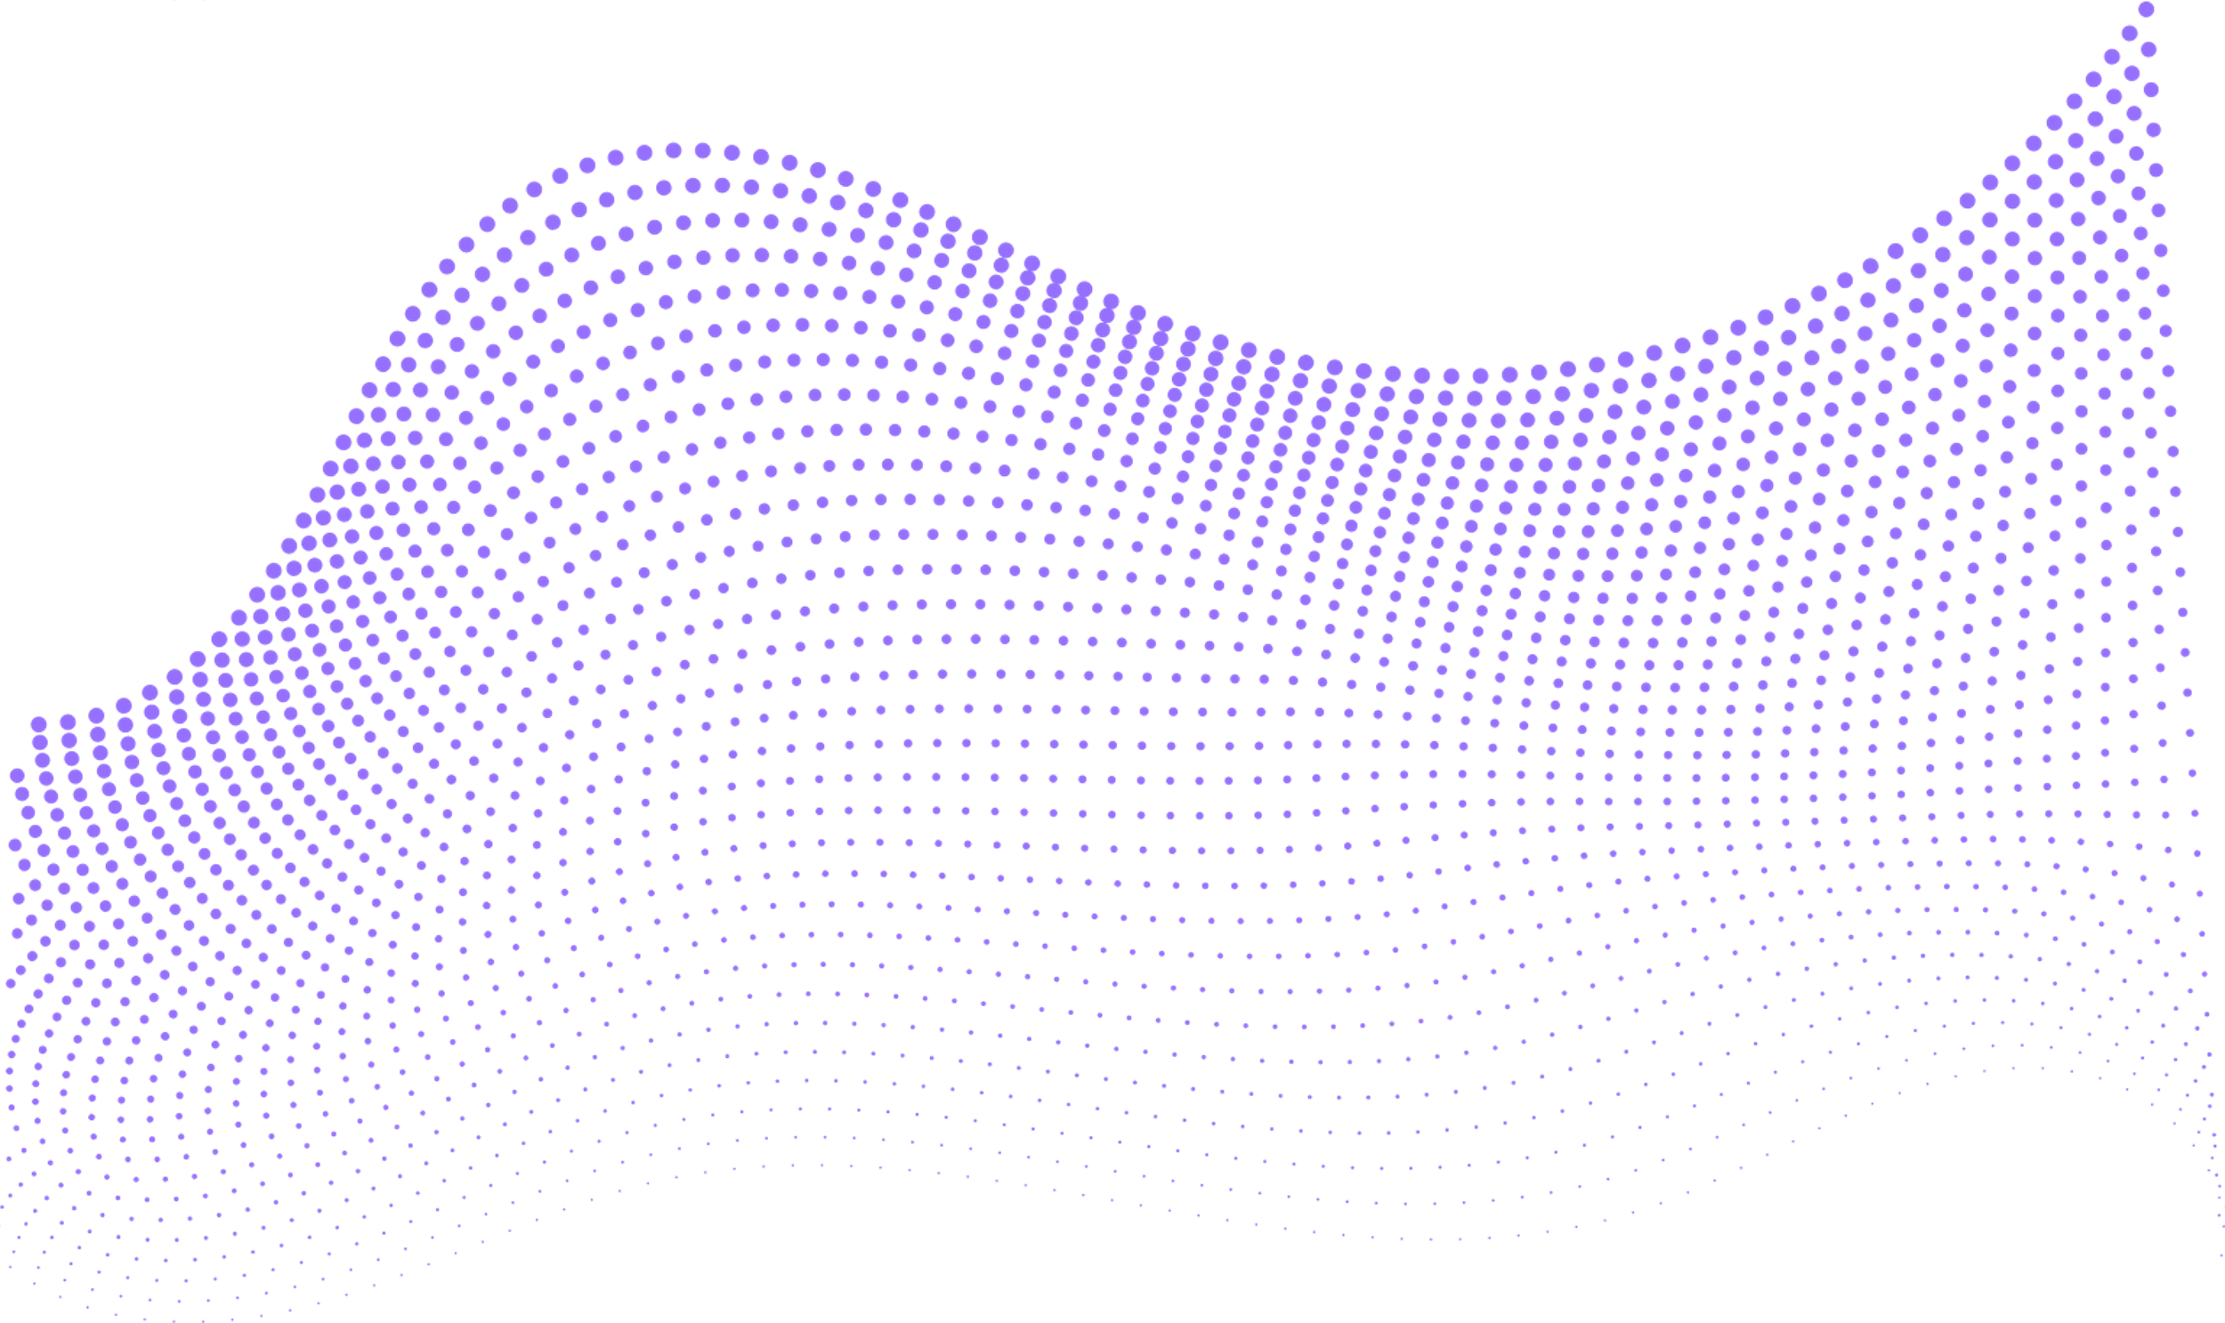
THE COURSES
WEB DESIGN AND PUBLISHING
SOCIAL MEDIA
VIDEO
SOCIAL MEDIA
ANALYTICS PLATFORMS
Students leverage AI-generated visuals to create high-quality product photos for a mock business website. This allows them to explore real-world applications of AI in digital branding and website design.
Students use AI-powered video generators to produce a commercial for an mock business concept they develop. This hands-on experience combines creativity, storytelling, and emerging tech to simulate modern content creation workflows.
Students integrate AI-generated imagery and captions to design professional social media content for a real-world brand partner. This activity emphasizes strategic thinking, visual communication, and the evolving role of AI in social marketing.

Slide 3

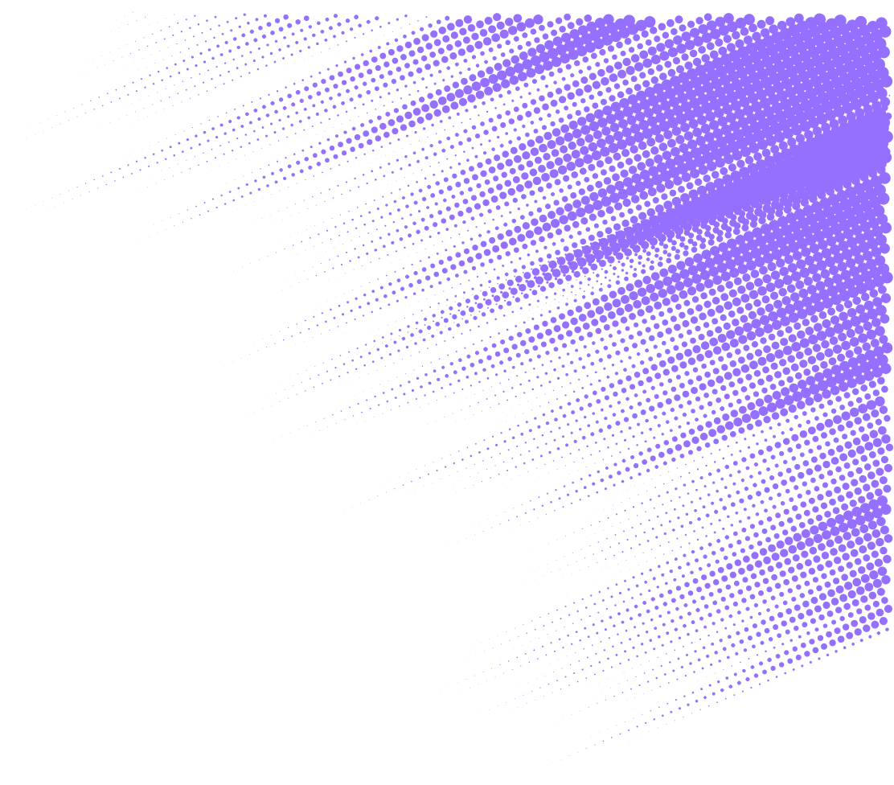
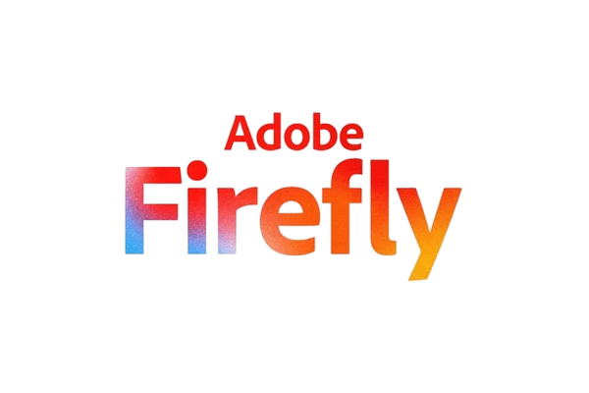


WEB DESIGN AND PUBLISHING

Slide 4
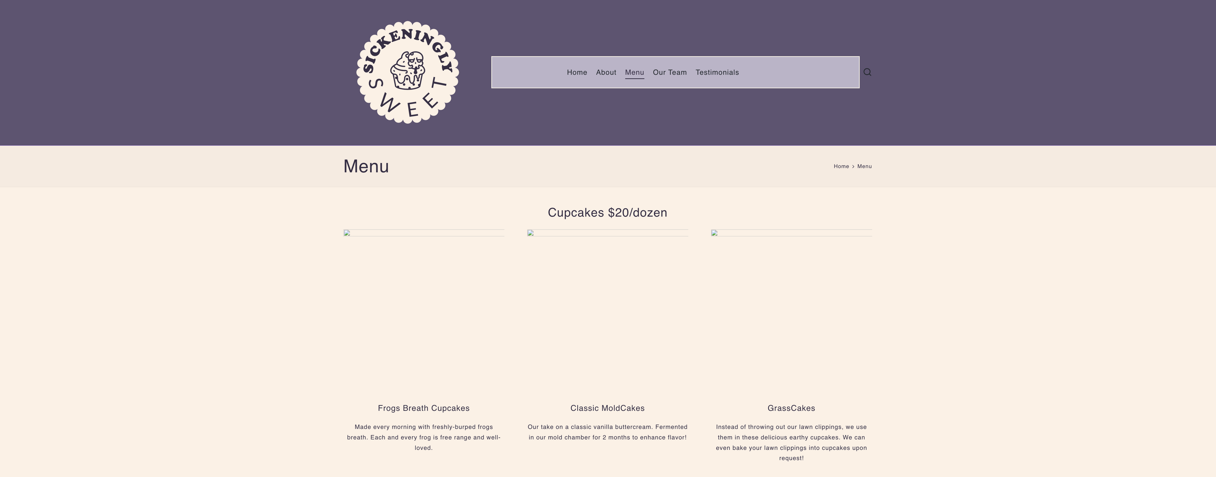
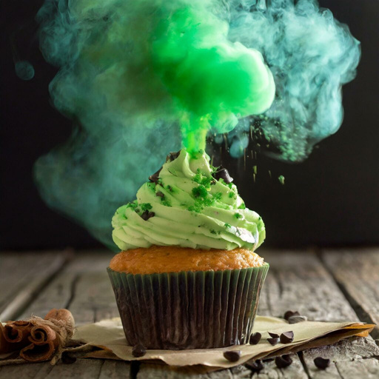

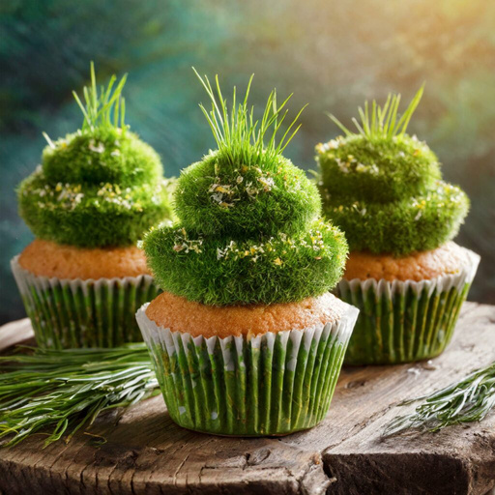

Slide 5
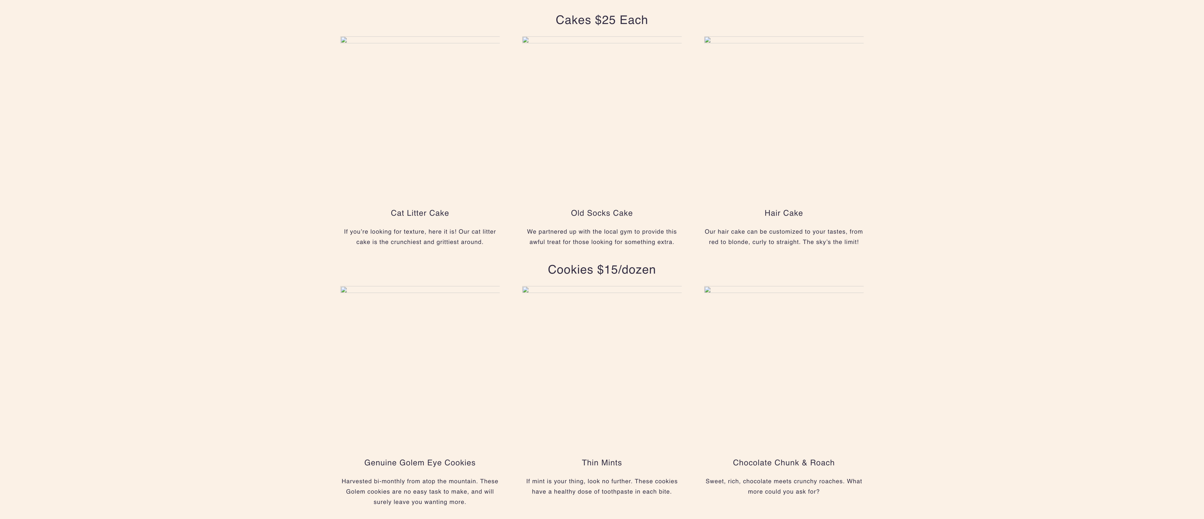
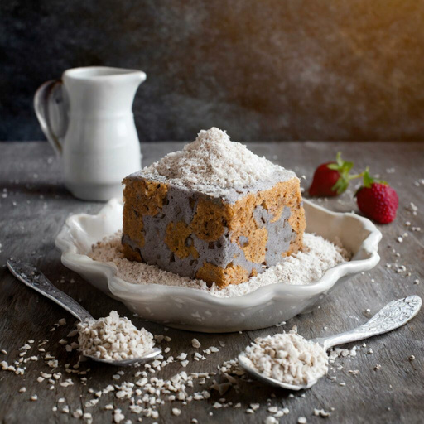


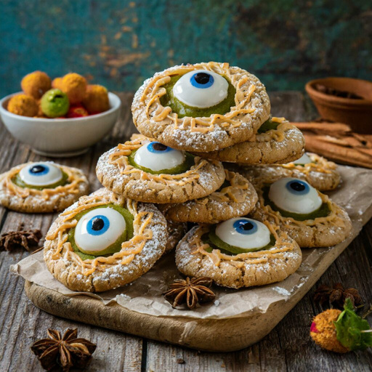
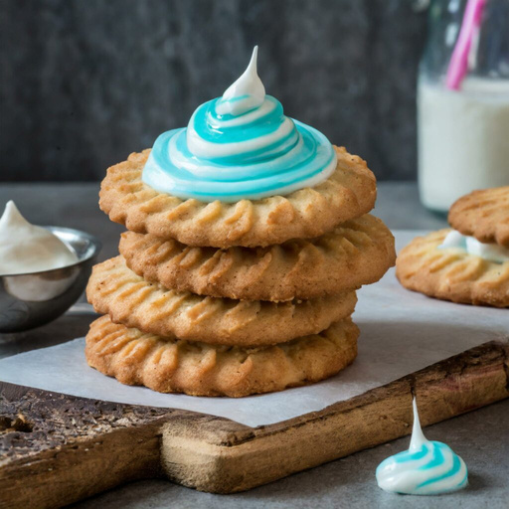


Slide 6
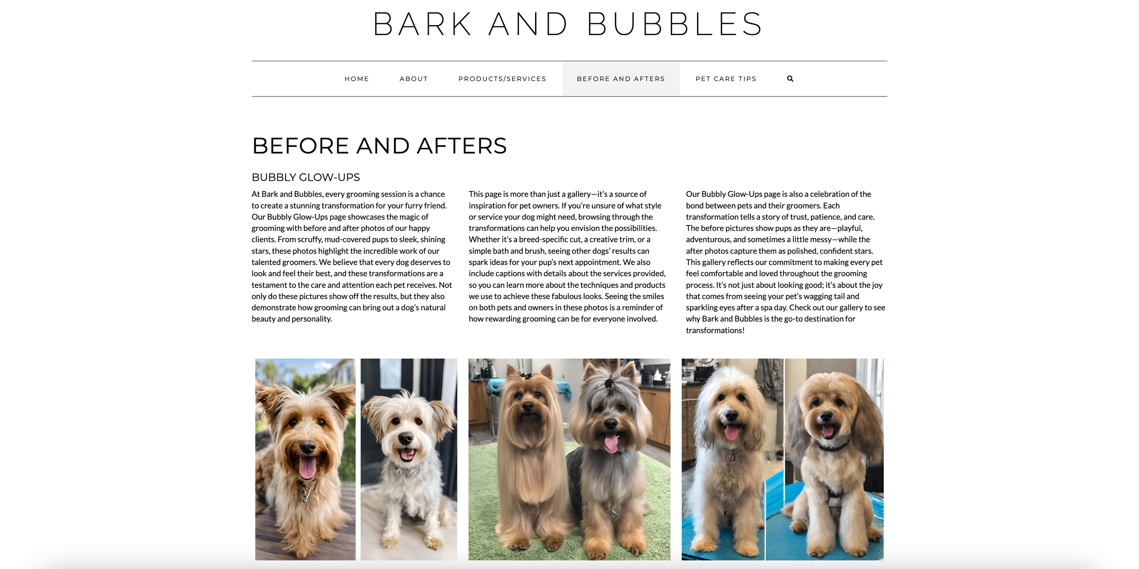

Slide 7



SOCIAL MEDIA VIDEO

Slide 8
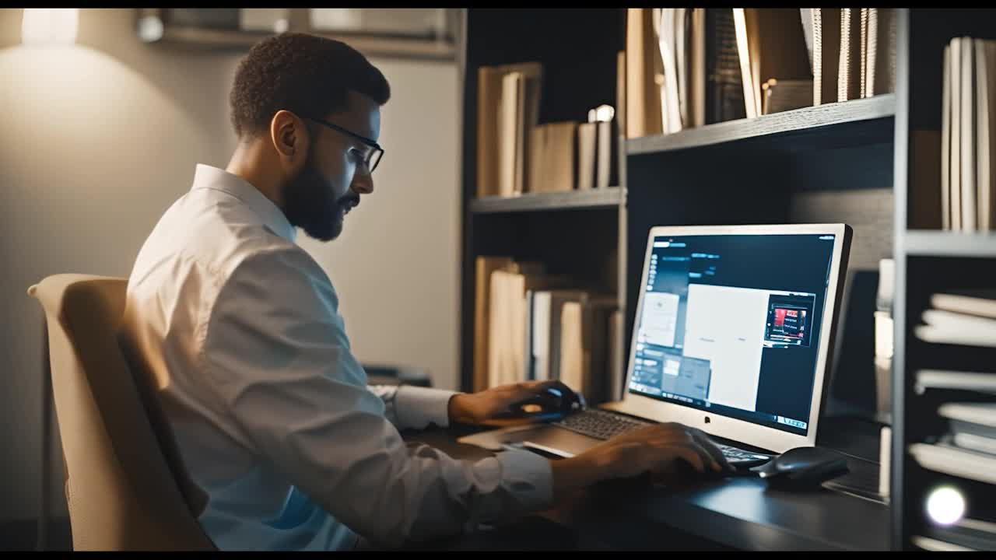

Slide 9
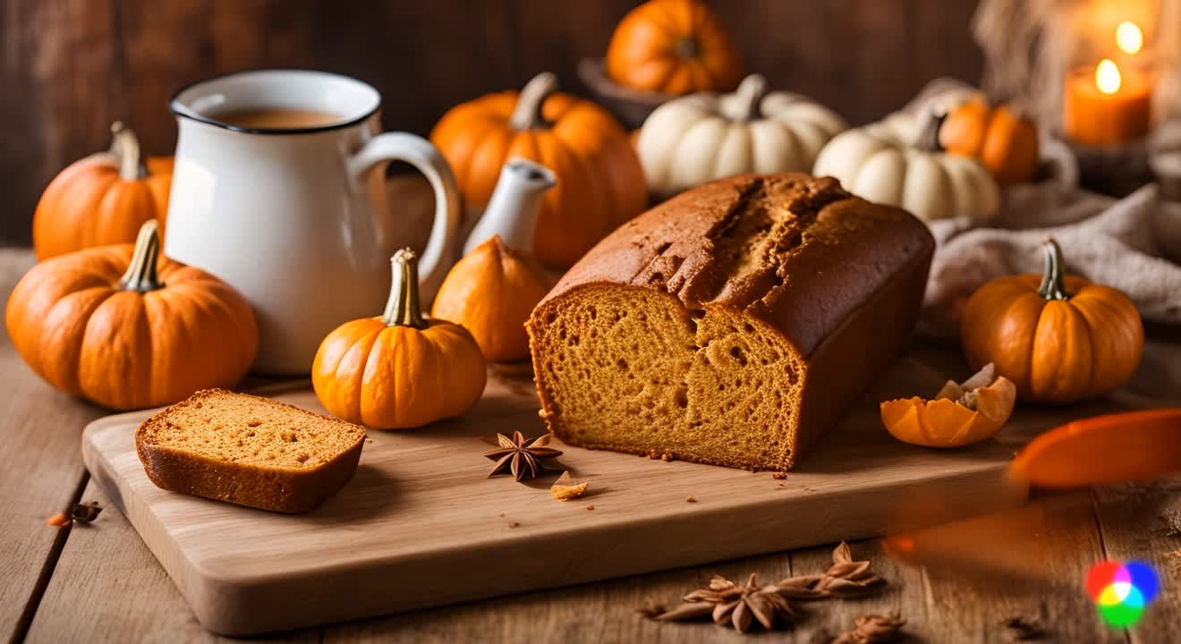

Slide 10
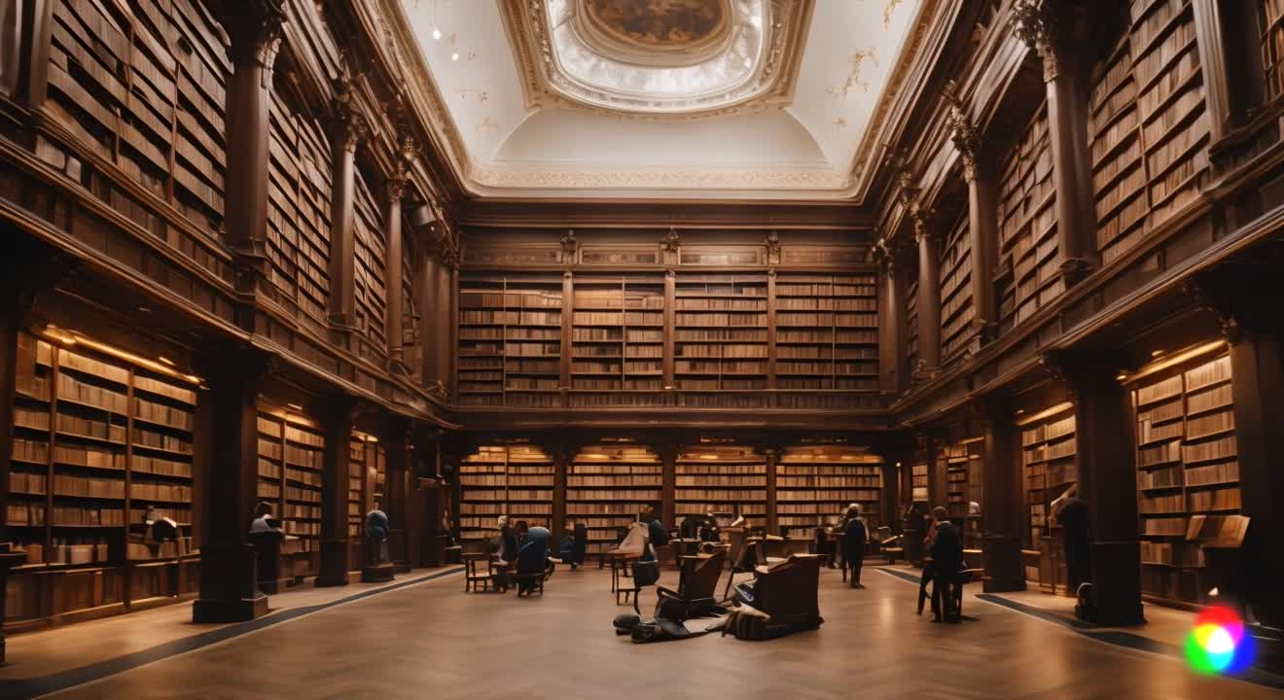

Slide 11

SOCIAL MEDIA ANALYTICS PLATFORMS

Slide 12
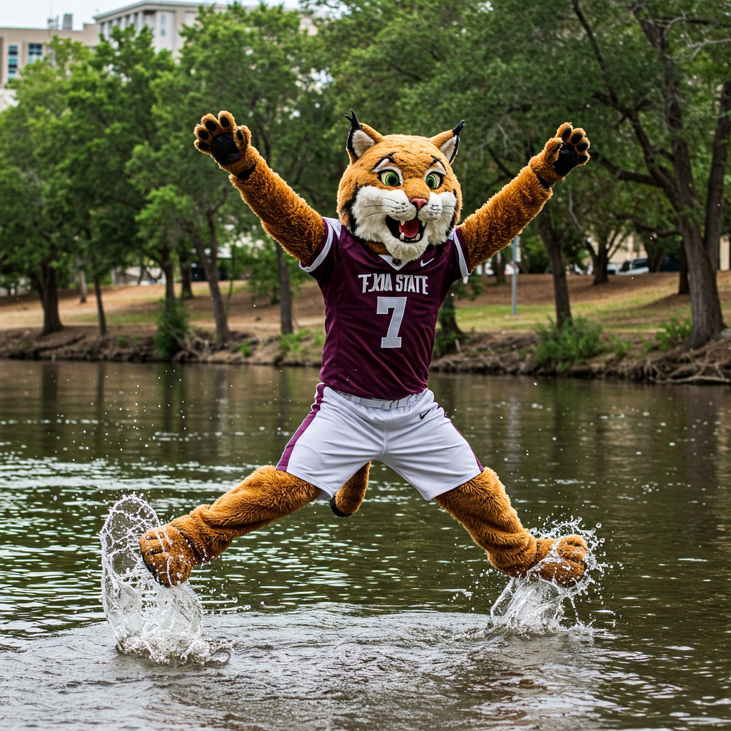
"So proud to be a Bobcat! Congrats to all the graduates!"
Then students discuss whether or not the brand would use the AI generated content, explaining the caption and image suitability.

Slide 13
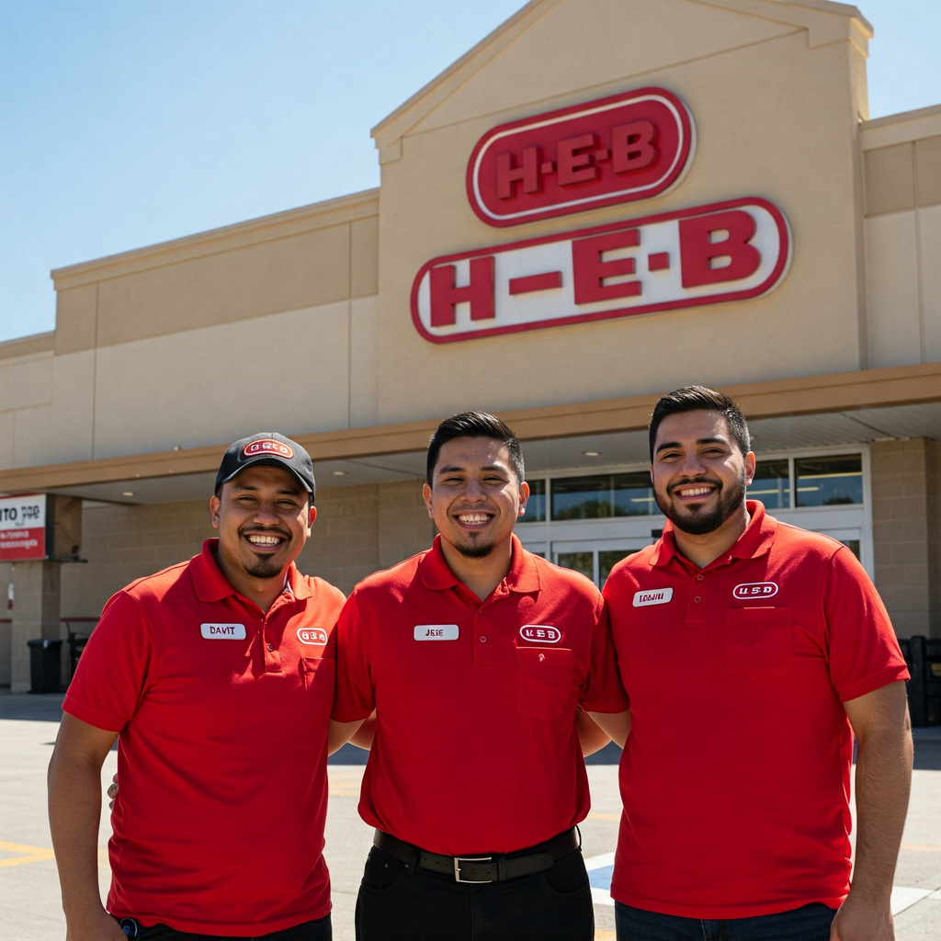
"Perfect day for a perfect job!
☀️ #HEB #LoveMyJob"
Then students discuss whether or not the brand would use the AI generated content, explaining the caption and image suitability.

Slide 14
THANK YOU

